Slide 1

BandWay
Ido Bitton Tal Yamin

Slide 2
Overview
BandWay is a revolutionary concert vacation planning system designed to provide users with an unparalleled experience in organizing and enjoying their favorite music events. Leveraging cutting-edge technology and intelligent algorithms, BandWay offers personalized recommendations, seamless booking processes, and comprehensive trip management features.

Slide 3
The problem
Planning a concert vacation is complex and fragmented.
Music enthusiasts must coordinate multiple trip aspects: finding concerts, booking tickets, arranging accommodations, and organizing travel.
This process typically involves navigating various platforms and services, which is time-consuming, frustrating, and prone to errors.

Slide 4
Solution
Provides a unified, intelligent platform to streamline the entire planning process.
Facilitates seamless booking for concert tickets, hotels, and transportation.
Integrates all functionalities into a single cohesive system.
Ensures a hassle-free and enjoyable concert vacation planning experience.
Allows users to focus on their love for music rather than logistical challenges.

Slide 5
Website
Demo video

Slide 6
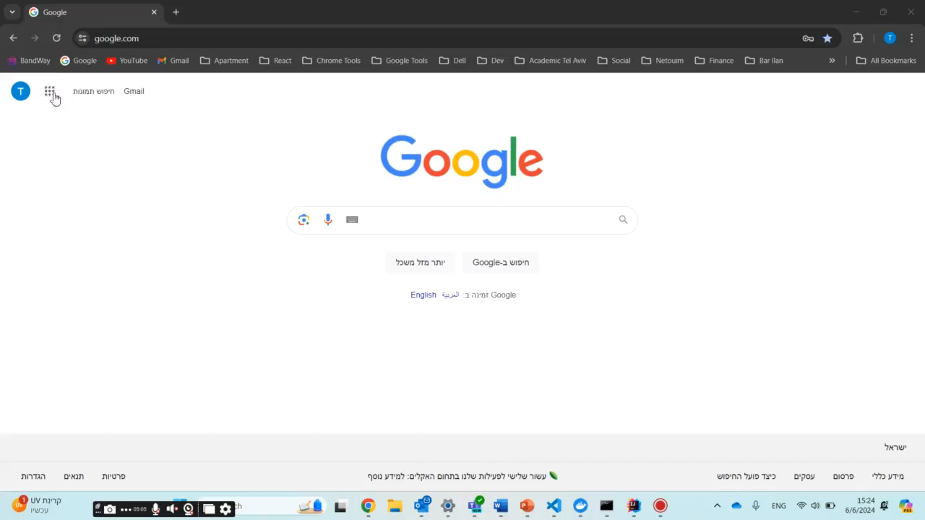

Slide 7
Infrastructure
Cloud Computing:
The system is hosted on cloud infrastructure, ensuring it can scale to accommodate a large number of users and handle varying loads efficiently.
API Integration:
Integrates with external APIs for booking concert tickets, hotels, and car rental. This allows BandWay to offer real-time availability, pricing, and seamless booking experiences.
Web Technologies:
Email Subscription Service:
Users can subscribe to receive notifications about new concerts, special deals, and exclusive offers via email. This service ensures users stay informed about events and promotions that match their interests.
clean and easy-to-use interface, built with the latest technologies. These tools ensure the site is fast, responsive, and works well on any device. The design is intuitive, making it simple for users to navigate and plan their concert vacations.

Slide 8
Technology
Spring
Java
Hibernate
Typescript
JavaScript
React
Material UI
Rapid API
Postgres
Docker
GitHub

Slide 9
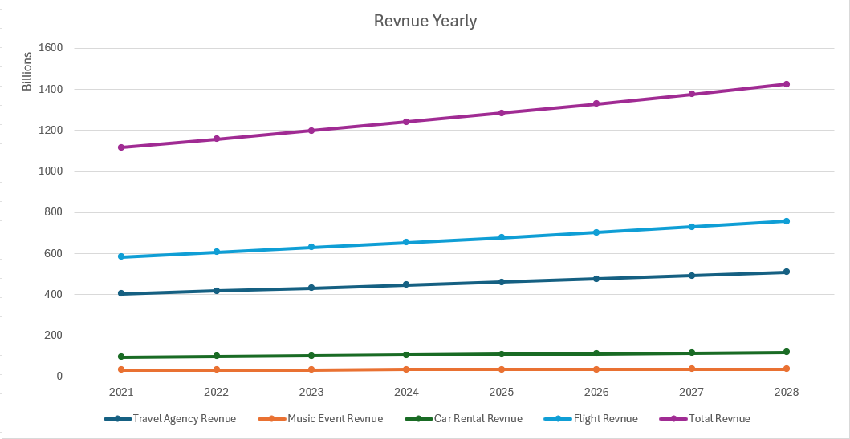
Marketing
The Hotels booking market size is projected to grow by 15.6% (2022-2028)resulting in a market volume of $508.9 by 2028, from $446.50B in 2021. link
The Music Events market worldwide is projected to grow by 2.12% (2024-2028) resulting in a market volume of $37.22B in 2028, from $34.23B in 2023. link
The Car Rentals market worldwide is projected to grow by 3.14% (2024-2028) resulting in a market volume of $116.00B in 2028. from $102.50B in 2023. link
The Flight booking market worldwide is projected to grow by 3.75% (2024-2028) resulting in a market volume of $630B in 2028. from $730B in 2024. link

Slide 10



Competitive Landscape
Songkick:
Strengths: Well-established platform for discovering concerts and tracking favorite artists. Provides personalized concert alerts and integrates with major music streaming services.
Weaknesses: Primarily focused on concert discovery and ticketing, with less emphasis on comprehensive trip planning and travel arrangements.
Bandsintown:
Strengths: Popular among users for real-time concert notifications and social features that allow fans to see which concerts their friends are attending.
Weaknesses: Limited travel and accommodation booking options, primarily focused on concert alerts and basic event management.
Eventbrite:
Strengths: Comprehensive event management platform with a wide range of event types, including concerts. Strong ticketing and promotion capabilities.
Weaknesses: Less specialized in music events and lacks integrated travel and accommodation planning features.

Slide 11
Management team
Ido Bitton:
I am a fourth-year computer science student living in Israel, with seven years of experience as a data engineer and backend developer. Beyond my professional life, I am happily married, dedicated father to one baby girl and a puppy dog owner .
Linkdin: https://il.linkedin.com/in/ido-bitton-b8a298163
Tal Yamin:
I am a fourth-year computer science student, currently working as a QA Automation Engineer. On a personal note, I have been happily married for nearly three years, and last month, I became a proud father to a beautiful baby boy.
Linkdin: https://www.linkedin.com/in/tal-yamin-5a478a173/

Slide 12
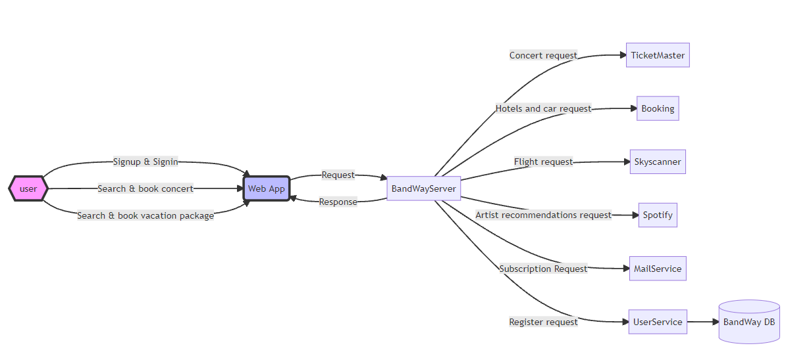
Architecture

Slide 13
Summary
BandWay is a revolutionary concert vacation planning platform designed to simplify and enhance the experience of organizing and attending music events. By modern web frameworks, BandWay offers personalized concert recommendations, seamless booking for tickets, accommodations, and travel, and comprehensive trip management tools. With features like social integration and email alerts for new concerts and deals, BandWay provides a user-friendly, all-in-one solution for music enthusiasts to plan unforgettable concert vacations effortlessly.

Slide 14
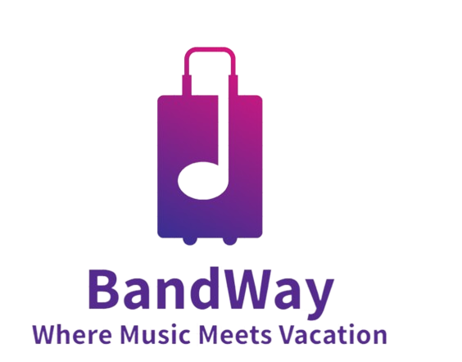
Thank You
Ido Bitton
Tal Yamin
https://Bandway.com

